Slide 1

Sixth Edition
Chapter 8
Experimental Designs: Between-Subjects Design

Slide 2
Introduction to Between-Subjects Experiments
Reminder: Why experiments? What’s the goal?
  Goal: to demonstrate a cause-and-effect relationship between two variables
  Requirements:
    Manipulation of one variable
    Measurement of a second variable
    Comparison of the scores between treatments
    Control of all other variables

Slide 3
Two Basic Research Designs
Between-subjects design
  Each set of scores is obtained from different groups of participants.
Within-subjects design
  Different sets of scores are obtained from the same group of participants.

Slide 4
Characteristics of Between-Subjects Designs
Experimental research wherein a researcher manipulates an IV ► then measures the DV for each participant
  Goal: to determine whether differences exist between two or more treatment conditions
  Requirement: Only one score for each participant is obtained
    Separate groups of participants are used for different treatment conditions.

Slide 5
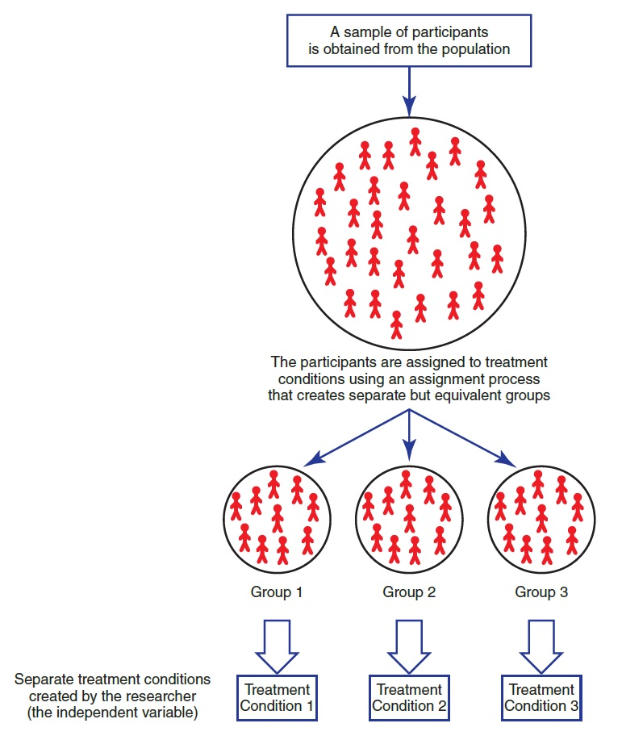
Notes:
There are some really important considerations when making our groups.
Random selection
Control for same confounds
Only thing that should differ is the manipulation

Slide 6
Advantages of Between-Subjects Designs
Each individual score is independent from all other scores.
The individual’s score is not influenced by:
  practice or experience gained in other treatments
  fatigue or boredom from participating in a series of different treatments
  contrast effects that result from comparing one treatment to another
Notes:
Why is independence an advantage?

Slide 7
Disadvantages of Between-Subjects Designs
Require a relatively large number of participants
  Example: three different treatment conditions with 30 scores in each treatment ► 90 participants are required
Each score is obtained from a unique individual who has personal characteristics different from all of the other participants.
  Individual differences
  How to control for individual differences?
Notes:
What’s the magic number for how many participants you might need?
The groups in a between-subjects experiment must be as similar as possible except for the IV distinguishing them.
If the groups are different, then individual differences can become confounding variables.
It then becomes impossible to draw conclusions about a treatment.

Slide 8
Individual Differences as Confounding Variables
The groups in a between-subjects experiment must be as similar as possible except for the IV distinguishing them.
  If the groups are different, then individual differences can become confounding variables.
    It then becomes impossible to draw conclusions about a treatment.

Slide 9
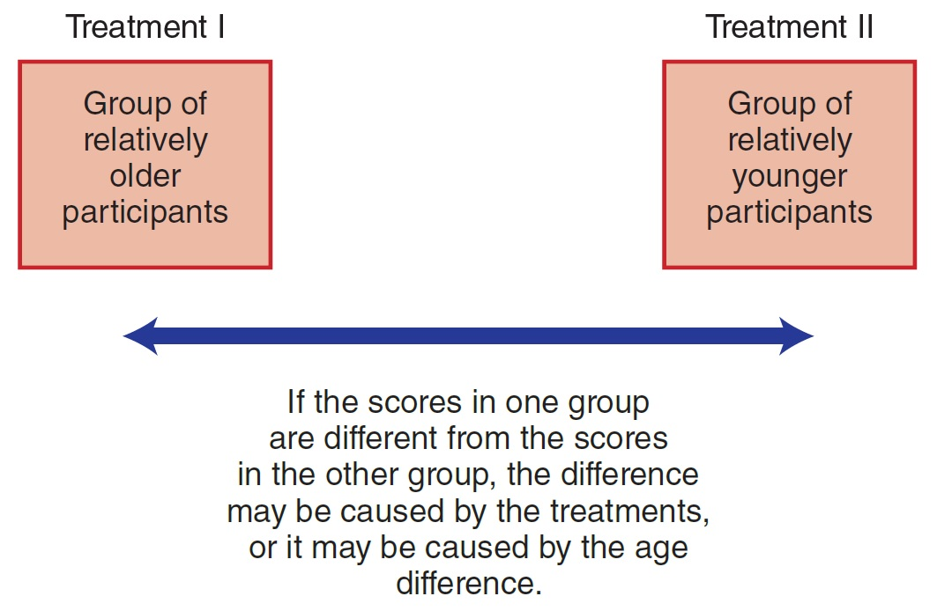
Age as a Confounding Variable
Notes:
What are some other variables we might need to control for?
Memory study
Testing a therapy
A study on political ideology

Slide 10
Additional Confounding Variables
Two major sources of confounding in between-subjects designs:
  Confounding from individual differences
    Example: participants in one group may be older, smarter, taller, or have higher socioeconomic status than the participants in another group.
  Confounding from environmental variables
    Example: testing one group as large group and another group as a small group.

Slide 11
Equivalent Groups
The researcher has control over creating groups that are equivalent.
  The separate groups must be:
    created equally
    treated equally
    composed of equivalent individuals
Notes:
Control!

Slide 12
Limiting Confounding by Individual Differences
Three primary techniques
  Random assignment (randomization)
    Assign participants to groups by a random process
  Matching groups (matched assignment)
    Match individuals in the group on a specific variable
  Holding variables constant
    Example: a researcher suspecting gender to be a confounding variable would eliminate gender as a variable.
Notes:
Example: medical trials often exclude women

Slide 13
Individual Differences and Variability
Effects of variability in between-subjects designs
  Large differences between individuals produce a large variance.
  Increasing (or decreasing) variance
    May have a significant influence on the statistical interpretation of the study results (significance)
    Significant means that it is very unlikely that the difference would occur if there was not a consistent difference between the treatment conditions.
Notes:
Variability! (what is it?)

Slide 14
Differences between Treatments and Variance within Treatments (1 of 2)
Large differences between treatments are good ► provide evidence of differential treatment effects.
Large differences within treatments are bad ► differences that exist inside the treatment conditions determine the variance of the scores.
  Large variance can hide patterns in the data!

Slide 15
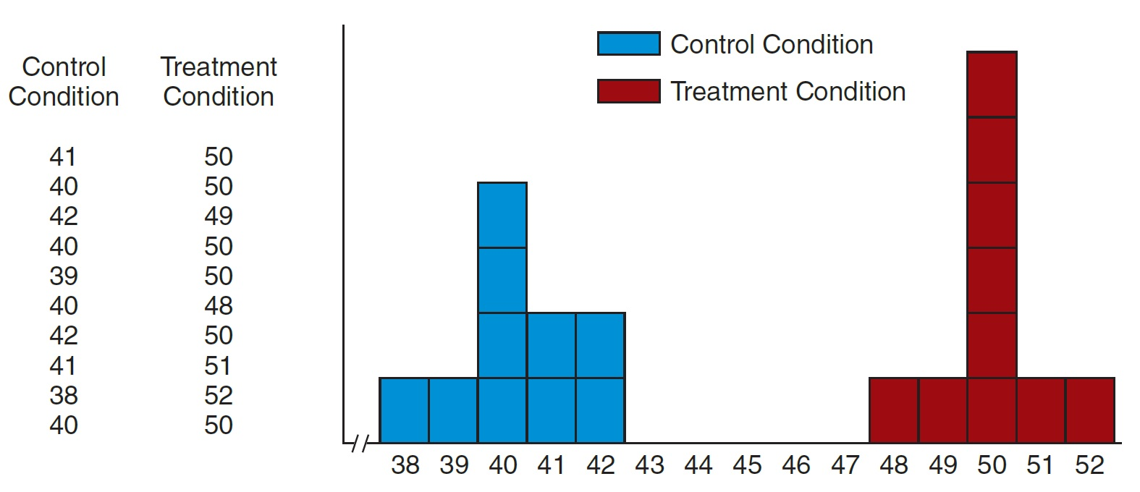
Experiment in Which Individual Differences Are Relatively Small
Small variance!
Notes:
Figure 8.3 Results from a Simulated Experiment Comparing Two Conditions Using Participants Selected from a Population in Which Individual Differences Are Relatively Small
When the individual differences are small, the variance is also small, and it is easy to see the 10-point treatment effect.

Slide 16
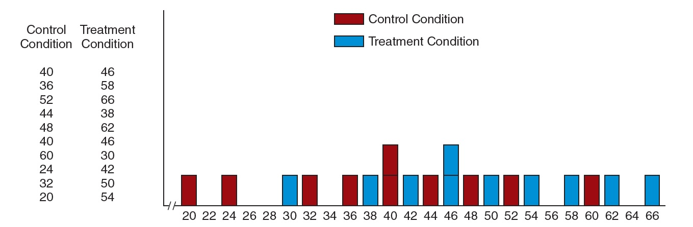
Experiment in Which Individual Differences Are Relatively Large
Large variance!
Notes:
Figure 8.4 Results from a Simulated Experiment Comparing Two Conditions Using Participants Selected from a Population in Which Individual Differences Are Relatively Large
When the individual differences are large, the variance is also large, and it is not at all easy to see the 10-point treatment effect.

Slide 17
Minimizing Variance within Treatments
Standardize procedures and treatment settings
Limit individual differences
Random assignment and matching
Sample size
  Bigger sample (usually) == larger variance

Slide 18
Other Threats to Internal Validity of Between-Subjects Designs
Differential attrition (participant dropout rate) from one group to another
  Large differences between groups create problems.
  How to handle?
  How to prevent?

Slide 19
Threats to Internal Validity
Communication between groups
  Diffusion: treatment spreads to the control group
  Compensatory equalization: subject demands treatment received by the other group
  Compensatory rivalry: control group changes their normal behavior (works extra hard)
  Resentful demoralization: participants in control group become less productive and less motivated

Slide 20
Applications and Statistical Analyses of Between-Subjects Designs
Two-group mean difference (single-factor two-group design or the two-group design)
  Simplest version of between-subjects experimental design
    Involves comparing the means (averages) of two groups of participants
    Researcher manipulates one IV with only two levels.
  Independent-measures t test shows if there is a significant difference between the means.

Slide 21
Advantages and Disadvantages of the Two-Group Design
Primary advantage: simplicity
  Provides best opportunity to maximize the difference between the two treatment conditions; opposite extreme values can be selected for the IV
Primary disadvantage: provides little information
  Researcher obtains only two real data points for comparison.
  Limits a study to two groups

Slide 22
Comparing Means for More Than Two Groups
Single-factor multiple-group design
  Example: comparing driving performance under phone use conditions
    Caution: possible to have too many groups in a research study
  Analyzed with a single-factor analysis of variance (ANOVA) (independent measures)
  Provides stronger evidence for a real cause-and-effect relationship than a two-group design

